Slide 1
Linux
Essential Commands

Slide 2
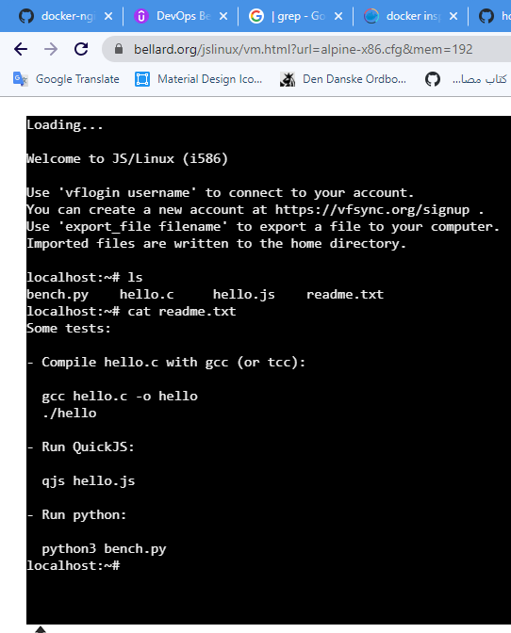
Practice Online
https://bellard.org/jslinux/

Slide 3
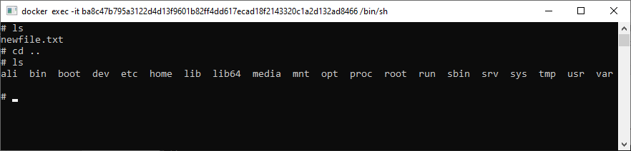
ls
directory list

Slide 4
cd
Change directory

Slide 5
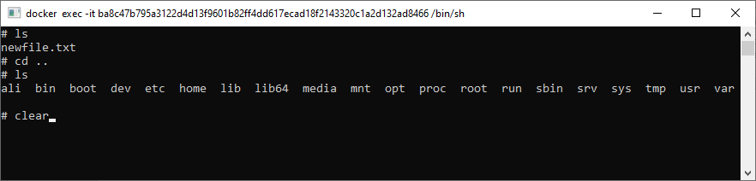
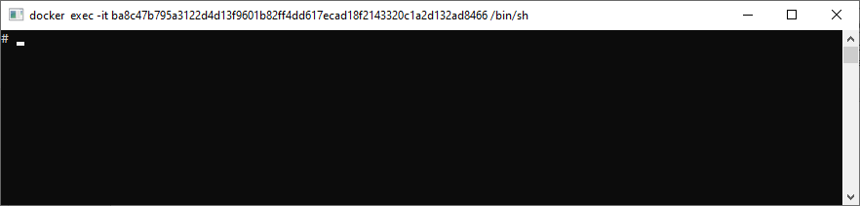
clear
Clear the Screen

Slide 6
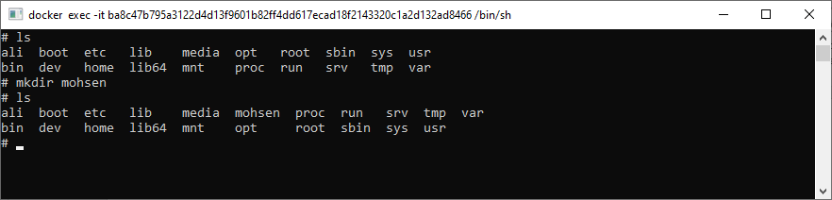
mkdir
Make directory

Slide 7
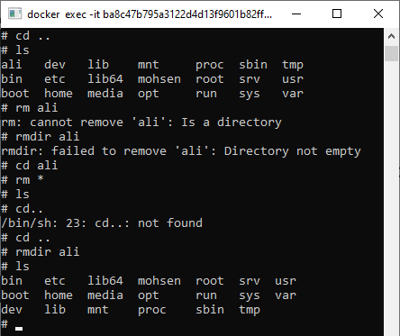
rm & rmdir
rm removes file(s)
rmdir removes directory(s)

Slide 8
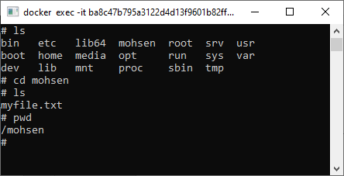
pwd
show path

Slide 9
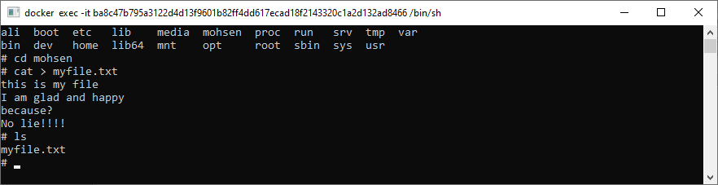
cat >
create new file by >
End with ^D

Slide 10
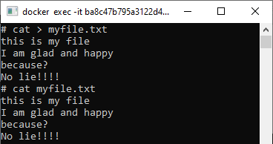
cat
Display file content

Slide 11
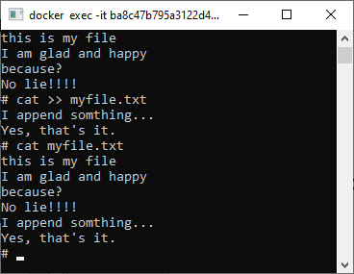
cat >>
append to a file

Slide 12
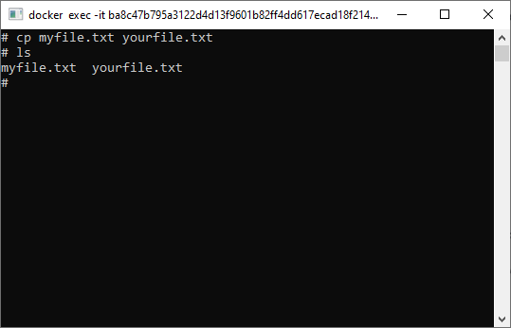
cp
Copy

Slide 13
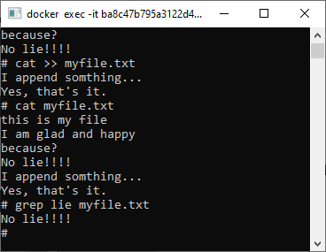
grep
Shows all sentences including my pharase

Slide 14
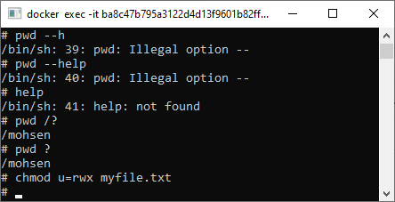
chmod
Set file(s) attribute

Slide 15

chmod

Slide 16
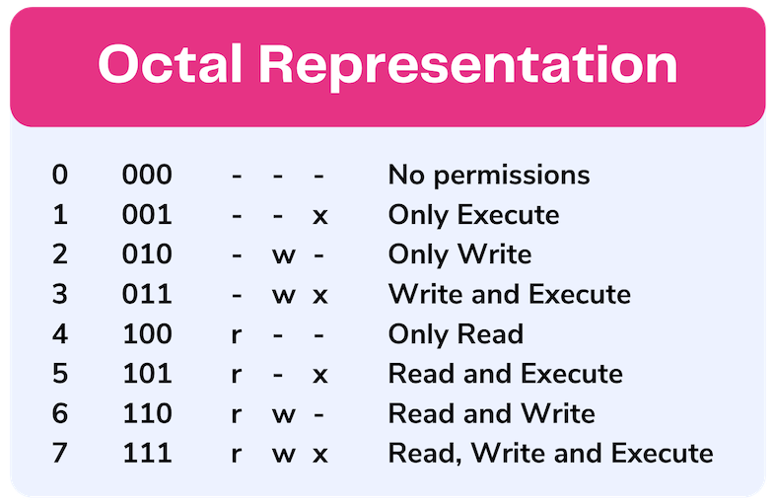
chmod
Set file(s) attribute

Slide 17
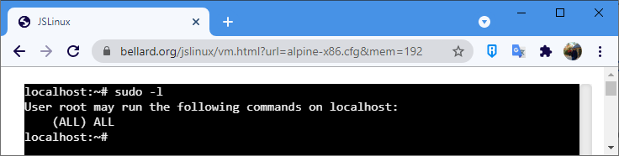
sudo -l
Display user and privilages

Slide 18
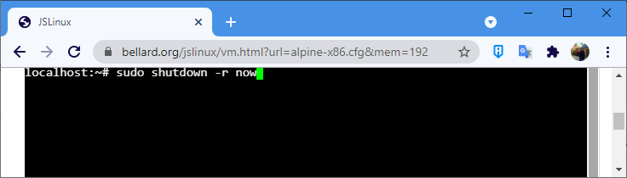
Restart the system

Slide 19
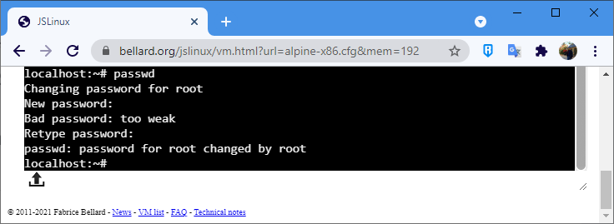
passwd

Slide 20
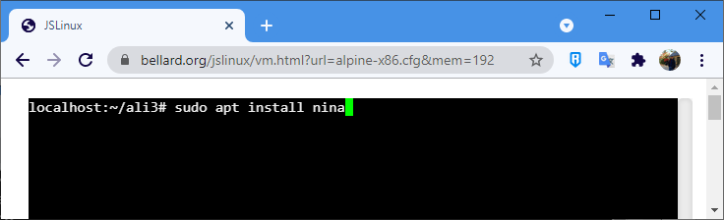
install
Nina is a famous text editor
ubuntu uses apt sub-command

Slide 21
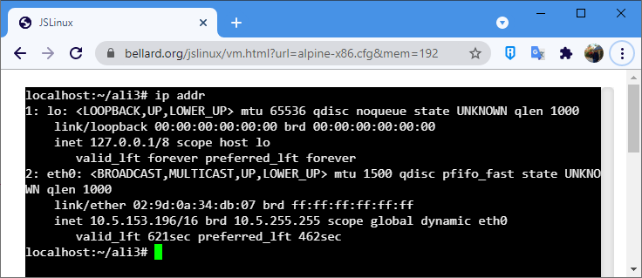
ip addr

